Slide 1


Bilingual Term Extraction with Big Data
Precision & Recall: A story of tradeoffs
Dr. Mark Cieliebak
CEO @ SpinningBytes
Rémy Blättler
Chief of the System @ Supertext
Jan Deriu
Research Assistant @ ZHAW

Slide 2
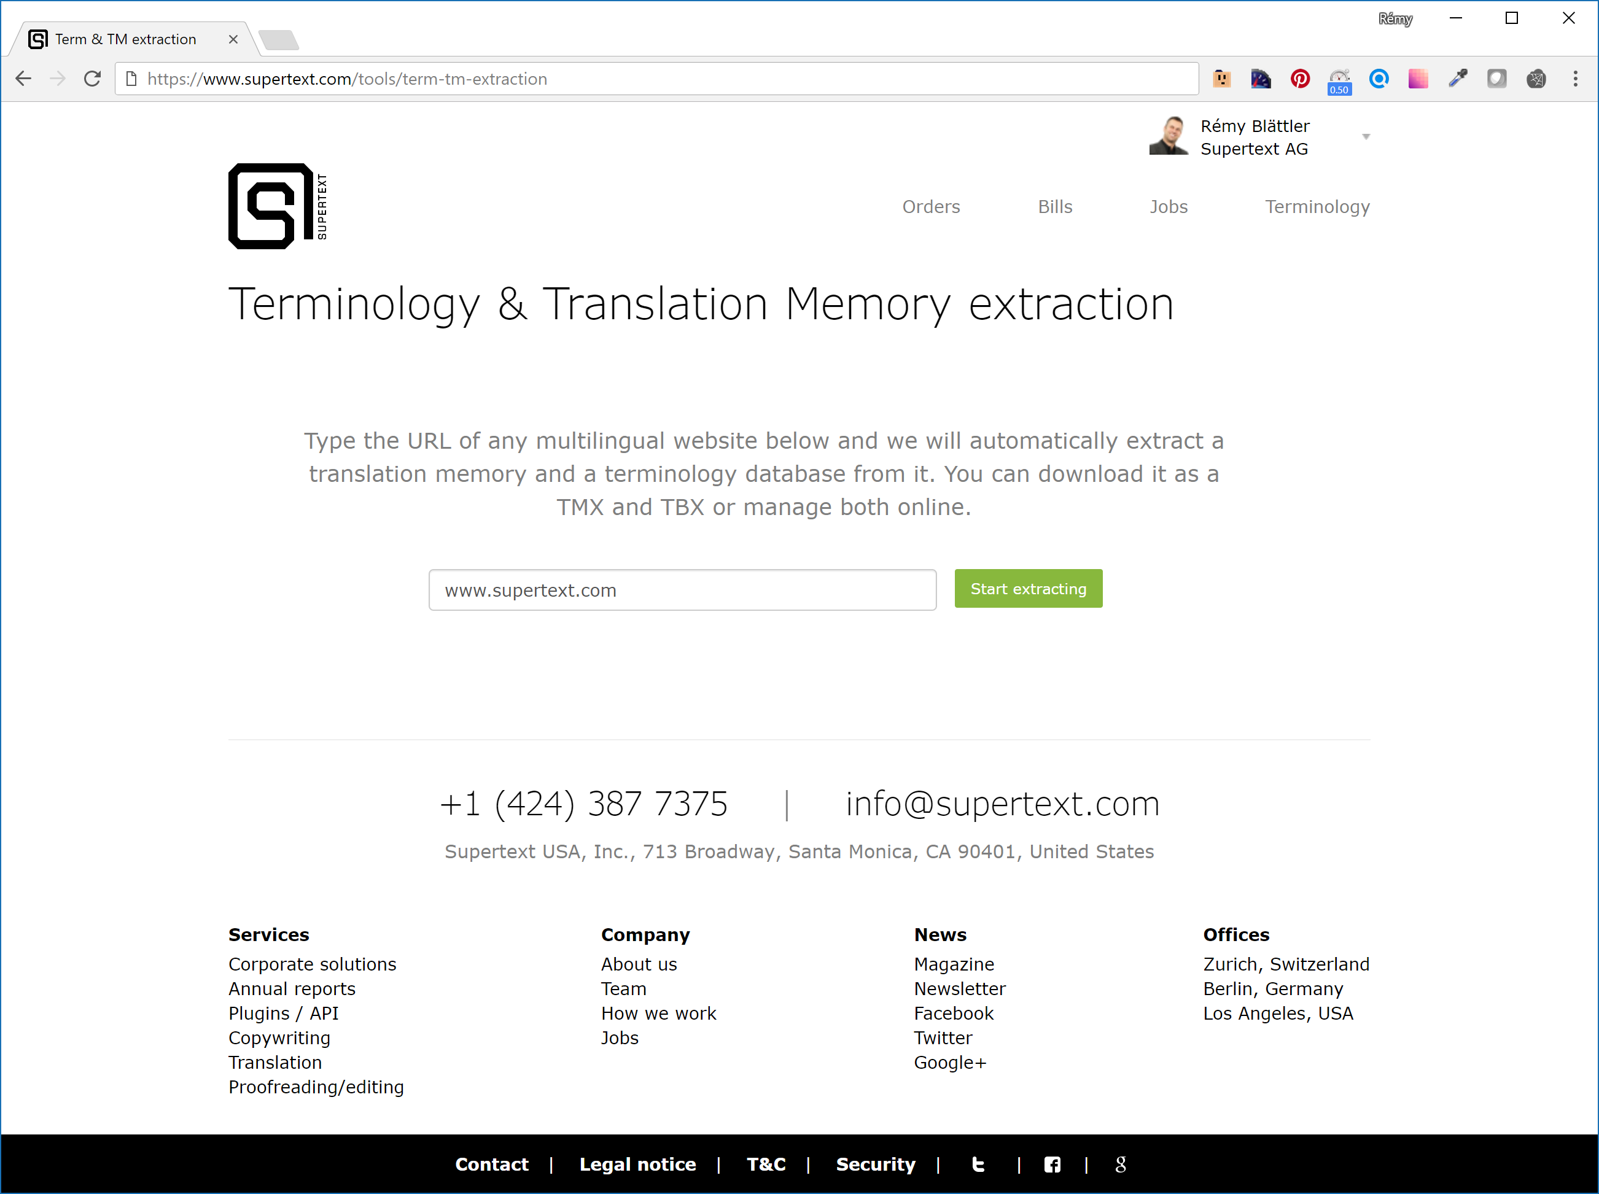
Notes:
WHY?
New clients
MT source
Advertising as cool company

Slide 3
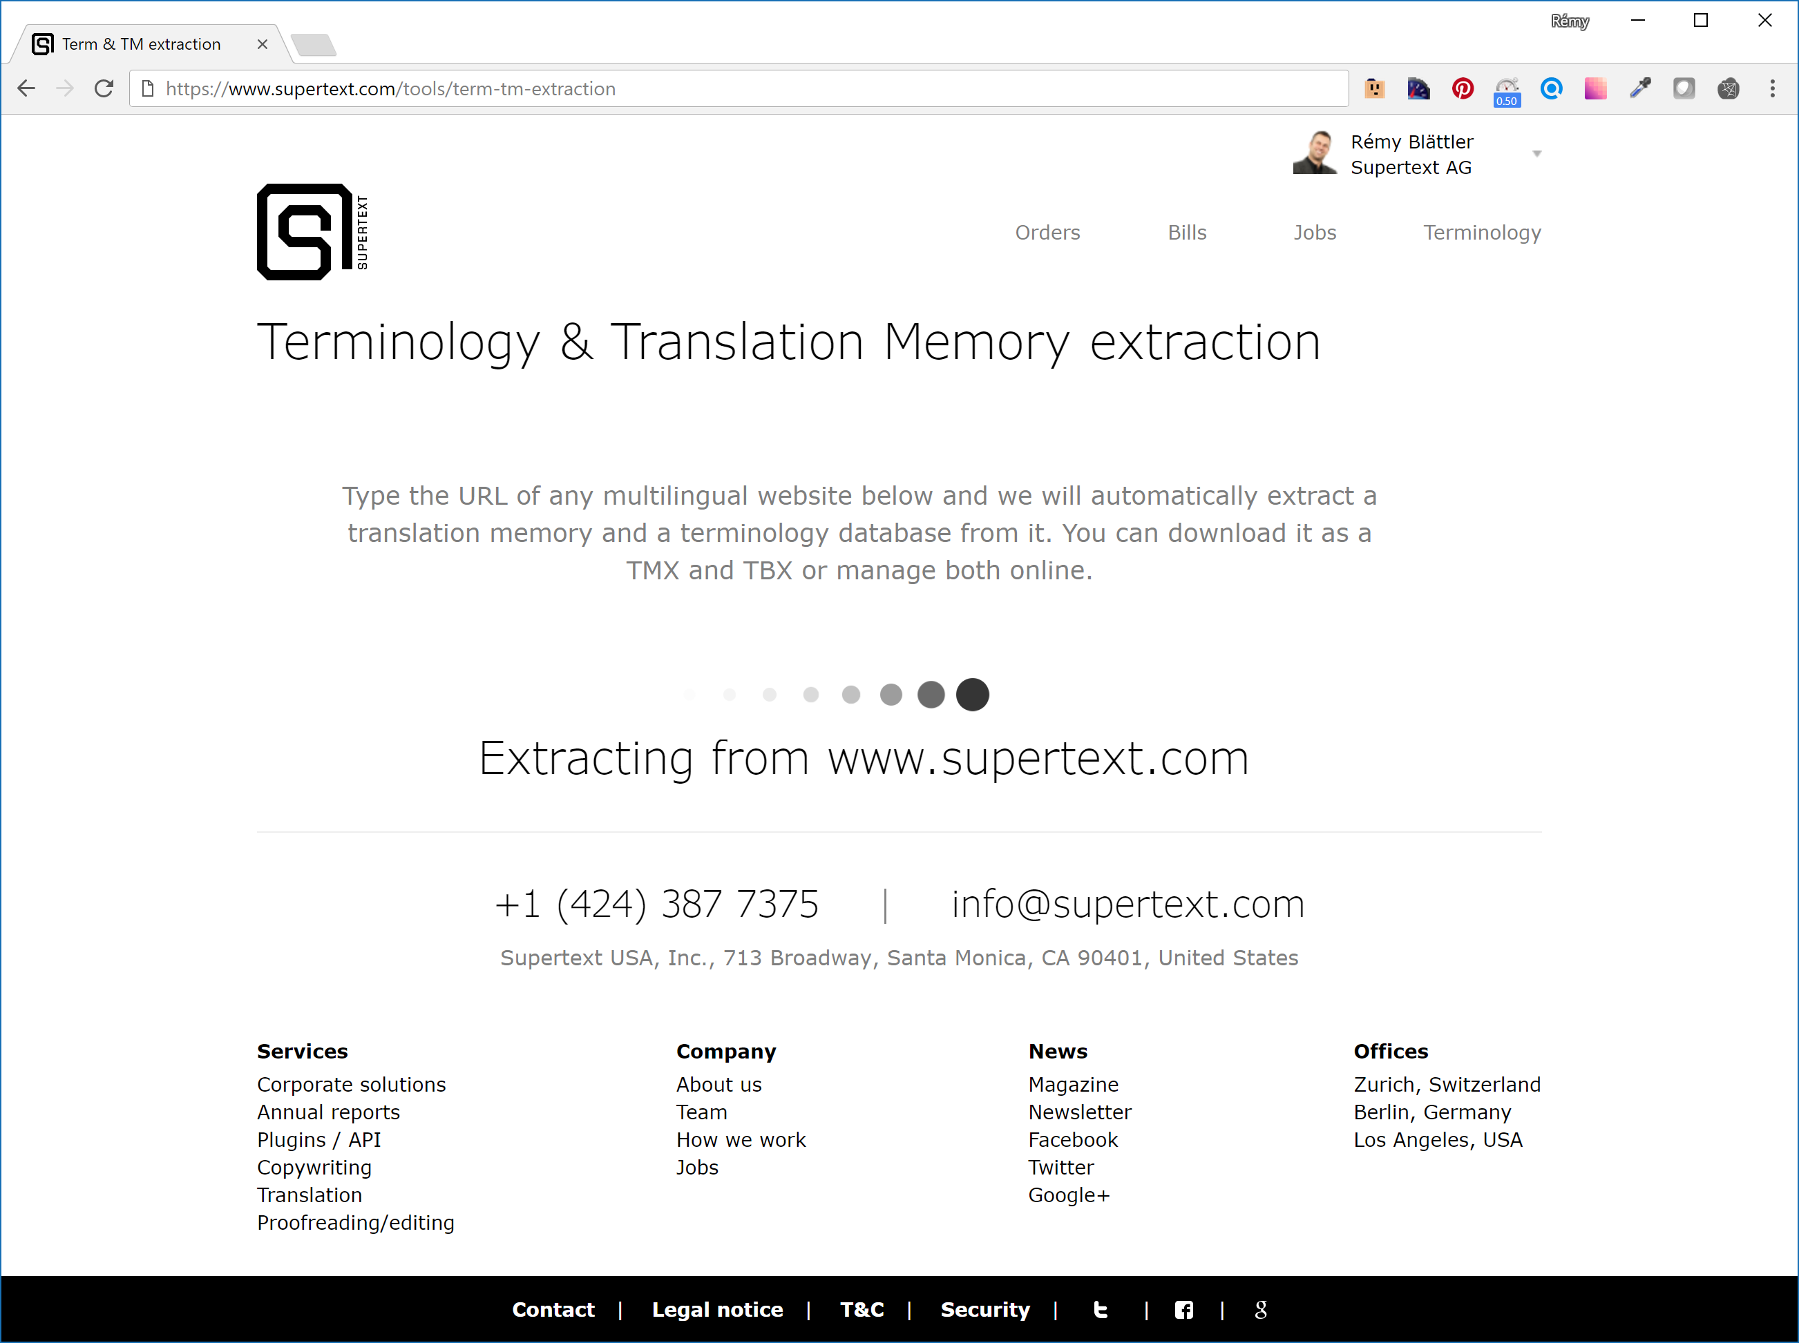

Slide 4
Web spider
(with Puppeteer)
Alignment with phrase matching
Term extraction
Structured text in multiple languages
Translation memory
Terminology database
Notes:
The whole end-to-end System does not exist yet, but lots of parts are developed or researched.
Not a 100% solution. If we get 50 – 70% we are happy.

Slide 5

Web spider
Puppeteer (Headless Chrome) can crawl JavaScript based pages.
Great for modern dynamic site.
Result: Structured (HTML) multilingual data
Notes:
Why?
To quickly create quotes for clients. Exclude unwanted pages.

Slide 6
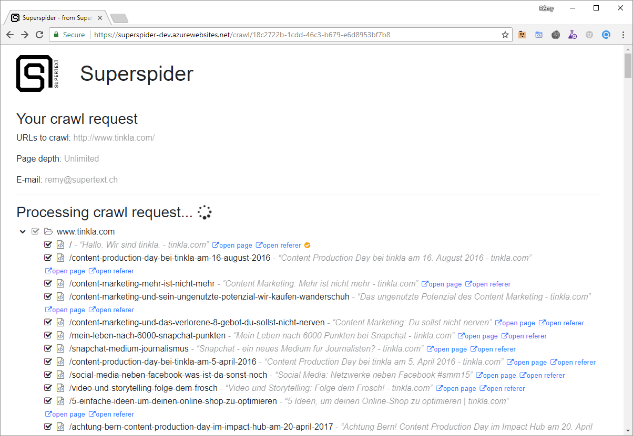
Notes:
About 1 month of work.
Lots of time lost due to new technology stack

Slide 7
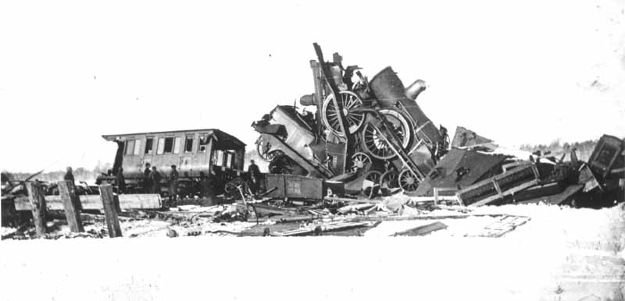
Problems
Speed
Multitasking / Scaling
Websites often difficult to spider
Notes:
Javascript
Timing

Slide 8

Match pages
HTML Links => Great, but often missing
Page structure => Bad for blogs
Content Matching => Complicated, but universal
Notes:
HTML Links:
<link rel="alternate" href="https://blog.supertext.ch/en/" hreflang="en" />
<a href="https://www.supertext.ch/en" lang="en-US">English</a>
Page structure:
Good for company pages, but blogs often have exactly the same structure for all pages
Content Matching:
Easy: Numbers, pictures, specific words
More complicated: Phrase matching

Slide 9

Match sentences
Almost all translation tool provider have a product in the market.
Commercial & free tools mostly bad
Usability & Results are not good

Slide 10
Match sentences
By length => Simple & bad
Translate first, match then (My genius idea)
Phrase based matching
=> lrec2016sentalign

Slide 11
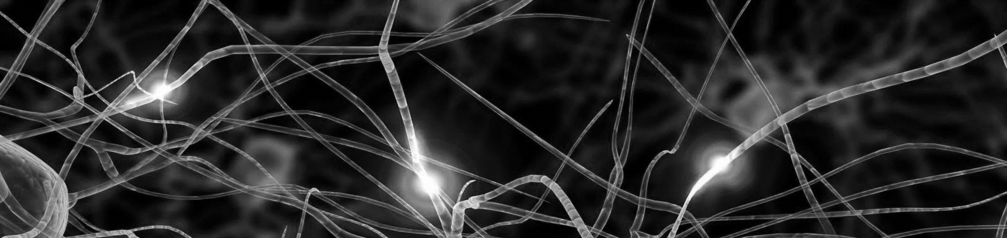
NMT Alignment
How can I create my own coupon template?
Wie kann ich eine eigene Gutscheinvorlage erstellen?
1. Translate
2. Align
Wie kann ich eine eigene Coupon-Vorlage erstellen?
Notes:
Used BleuAlign mit BleuScore

Slide 12
Phrase based matching
Doesn’t need machine translation
Bleuscore not very good for long sentences
=> Better than bluealign according to it’s creator
Notes:
Counter-Intuitive
Creator: Rico Sennrich
Bleu Score good for short sentences

Slide 13
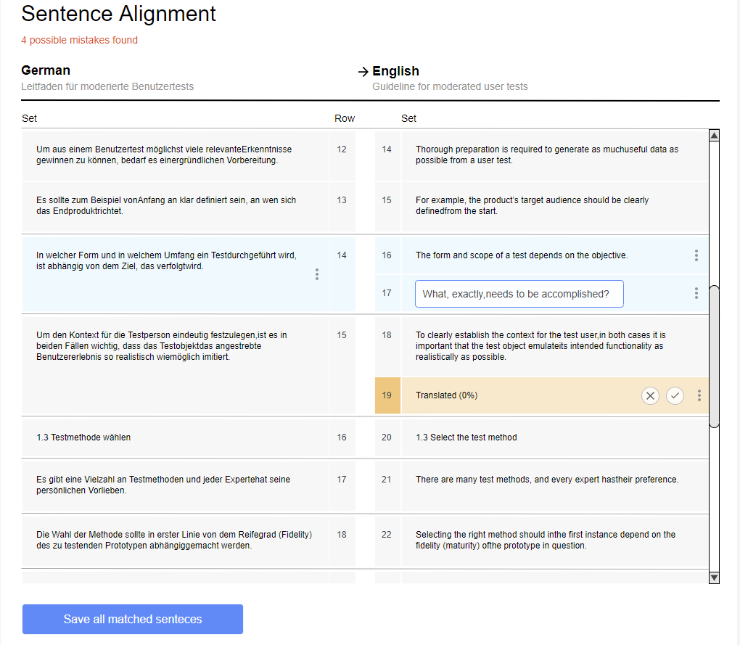

Slide 14
Problems
False positives
Best matching algorithm
  Gale-Church, Levenshtein, Bleu score
Notes:
False positives are really bad, so better less matches than wrong one.
Manual work is too expensive.

Slide 15
Term Extraction – A story of tradeoffs

Slide 16
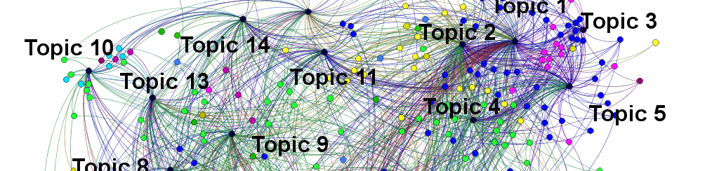
Scenario
Given: a corpus of translation memories (TM)
  We have 70 TM for 70 companies for German and English
  The translation is present sentence-wise
Goal: extract terms which are:
  Important for the company
  Translated uniquely

Slide 17
Example
.. des Verwaltungsrats zuhanden der Generalversammlung ..
.. by the Board of Directors to the General Meeting ..
Generalversammlung - General Meeting
Verwaltungsrats - Board of Directors

Slide 18
3 Phase Approach
Phrase Extraction
Important Term Extraction
Term Alignment

Slide 19

Phrase Extraction
Tomas Mikolov et. al. Distributed representations of words and phrases and their compositionality. NIPS 2013
Notes:
\text{score}(w_i, w_j) = \frac{\text{count}(w_i w_j) - \delta}{\text{count}(w_i) \times \text{count}(w_j)}
Two parameters: min-count and threshold

Slide 20
Tradeoffs
Choose between precision and recall
Too strict:
  Does not find obvious phrases: split-flap displays
Too liberal
  Finds nonsensical phrases: In den letzten
Notes:
Min_count, threshold
Too strict is unfortunate, because we might loose very interesting terms.

Slide 21

Term Extraction
Full Corpus
Company2
Company 1
Term Frequency(t,d):
How often term t appears for company d
Document Frequency(t):
For how many companies does term t appear
Goal:
Find terms that appear often in very few specific companies.

Slide 22
Tradeoffs
Where do we set the threshold?
To low -> lots of irrelevant words
To high -> we loose relevant words

Slide 23
Examples
Most problems stem from the Phrasing
Not so low term-frequency and low doc frequency
  a_possible_conflict, million_higher_and
  an_der_vorsorgeverpflichtung_per
Good examples often have a DF > 1
  Wind_farms
Notes:
Tf = 4 - 7
Df = 1
Cannot show good results are

Slide 24
Term Matching
.. des Verwaltungsrats zuhanden der Generalversammlung ..
.. by the Board of Directors to the General Meeting ..
Generalversammlung - General Meeting

Slide 25
Term Matching Problem
.. des Verwaltungsrats zuhanden der Generalversammlung ..
.. by the Board of Directors to the General Meeting ..
Generalversammlung - General Meeting
Verwaltungsrats - Board of Directors

Slide 26
Term Matching Problem
.. des Verwaltungsrats zuhanden der Generalversammlung ..
.. by the Board of Directors to the General Meeting ..
Generalversammlung - Board of Directors

Slide 27
Term Matching
Go trough all pairs of aligned sentences
Extract all the important terms

Slide 28
How well does it work?
Generalversammlung | General Meeting
der Konzernleitung | Group Executive Board
Mitglied des Verwaltungsrates | Member of
der BKW AG | BKW AG
Swissgrid | Swissgrid
Mio. CHF (Vorjahr | CHF million (previous year
Mio. CHF | CHF million
der BKW Gruppe | BKW Group
Wandelanleihe | convertible bond
Finanzinstrumente | financial instruments
so wäre | CHF million higher
Vorjahr | previous year

Slide 29
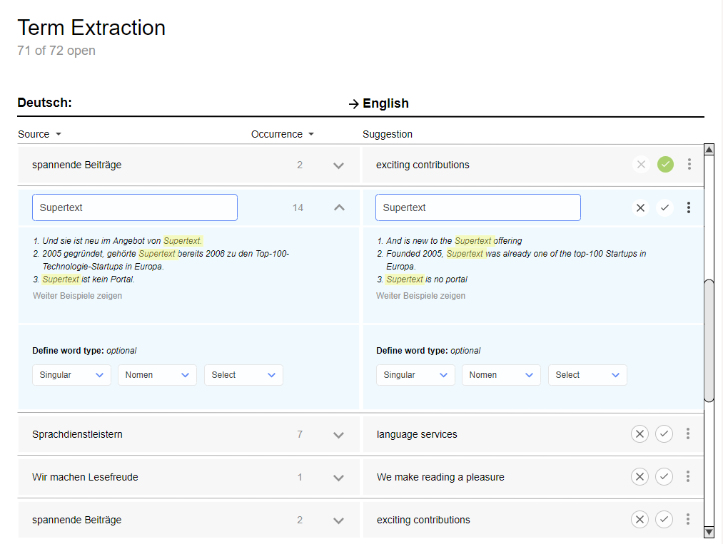

Slide 30
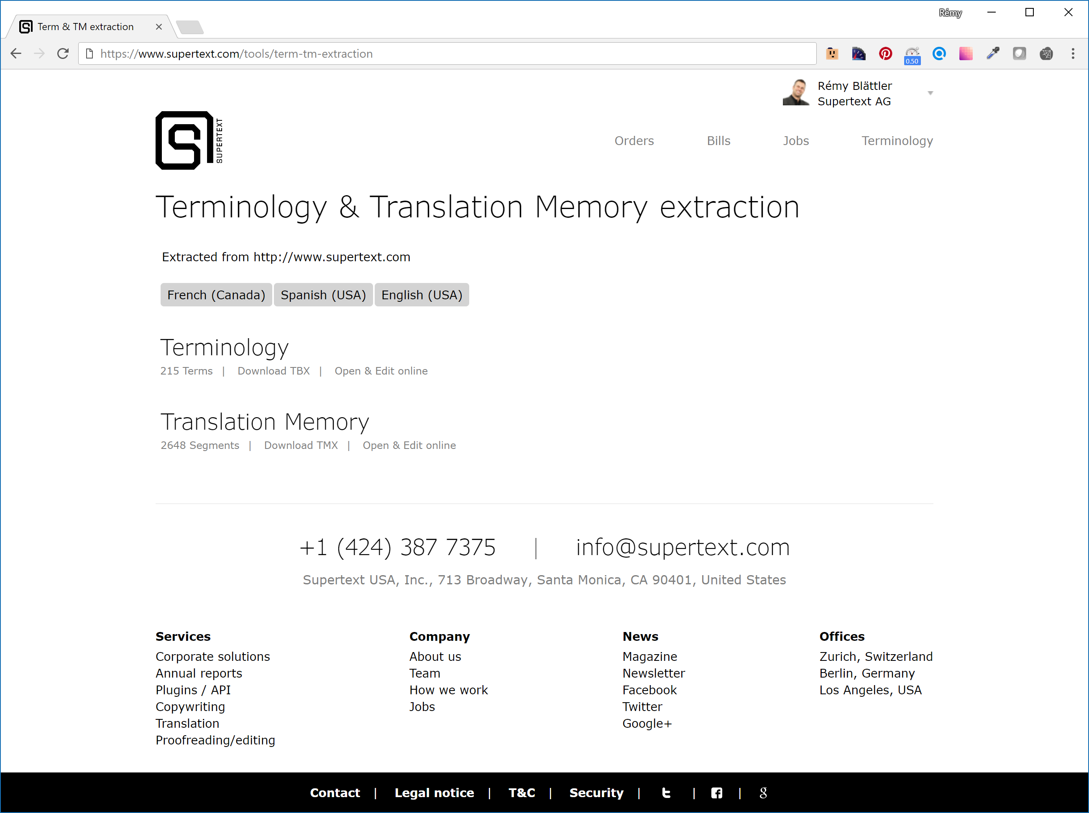

Slide 31

Questions?
@remyblaettler (Twitter)
remy@supertext.ch
@spinningbytes
deri@zhaw.ch

